Slide 1


VS
Notes:
Angular2 going to be a big learning curve for most us like Angular1 was
but ultimately I think it will be easier framework to use once we get our heads around the changes

Slide 2

Duncan Hunter
http://duncanhunter.com.au
@DuncHunter
Software Architect at SSW
Angular/TypeScript Focus
Rock climber

Slide 3

TypeScript or ECMAScript 6?
ES2015
Angular Super Powers Tour

Slide 4

Agenda
1. What is ES6?
2. ES6 versus TypeScript?
3. New ES6 features
4. Typescript 101
Notes:
Approx. 45min for the 10 qu and the Q&A

Slide 5

Life before TypeScript
No separation of concerns
Too much inline JavaScript
Poor code reuse
Nightmare to refactor
Join the Conversation #AngularSuperPowersTour @DuncHunter @AdamStephesen
Notes:
Read title and slide
It is not that we could not as much as preferred not

Slide 6

We will all need to make this decision?
A Typed
Superset of ES6

Slide 7
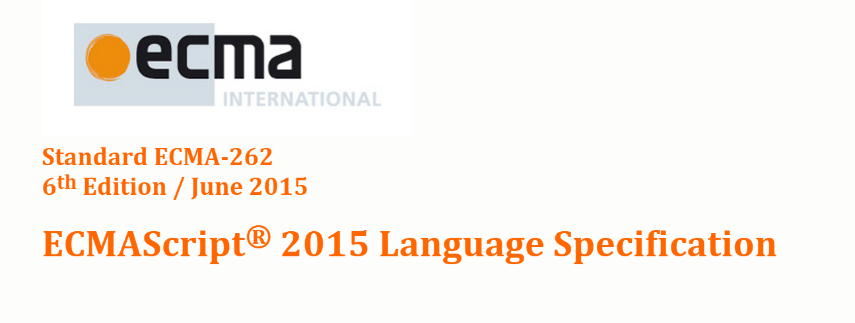
ECMAScript 6 is the current version First upgrade since 2009
Notes:
ES6 is a significant update to the language, and the first update to the language since ES5 was standardized in 2009.

Slide 8
arrows
classes
enhanced object literals
template strings
destructuring
default + rest + spread
let + const
iterators + for..of
Generators
Unicode
modules
module loaders
map + set + weakmap + weakset
proxies
symbols
subclassable built-ins
promises
math + number + string + array + object APIs
binary and octal literals
reflect api
tail calls

Slide 9
ECMAScript 6 vs TypeScript
No transpiling
No Types
Types
Requires transpiling
ES5
ES6
TS

Slide 10

Both will need to be transpiled to ES5

Slide 11
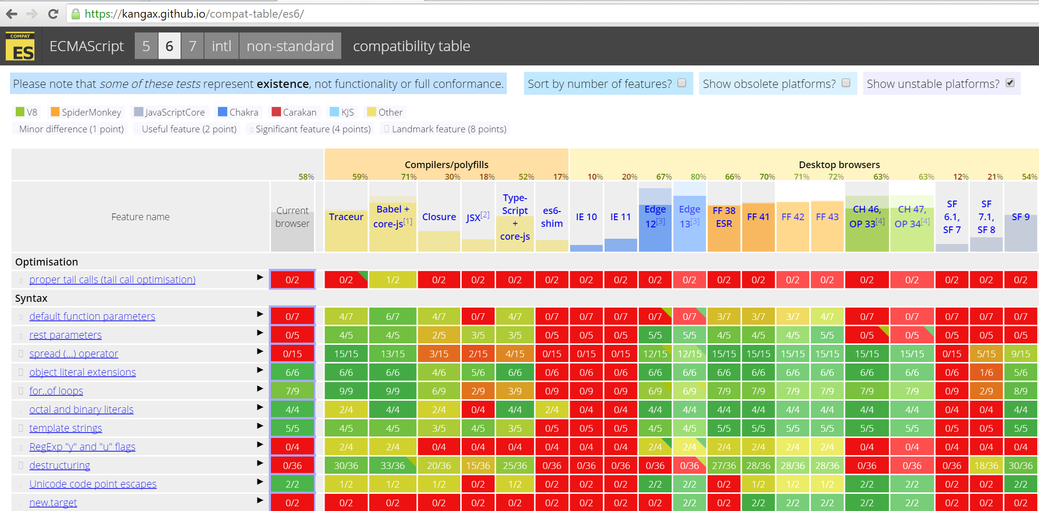

Slide 12
\
VS
ES6 features
No types
ES6 features
Types
Refactoring/IDE tools:
- Type saftey
- Auto completion
Go to definition
Rename on symbol

Slide 13
VS
Public/private
Interfaces
Enums
Generics
Optional properties
More….

Slide 14
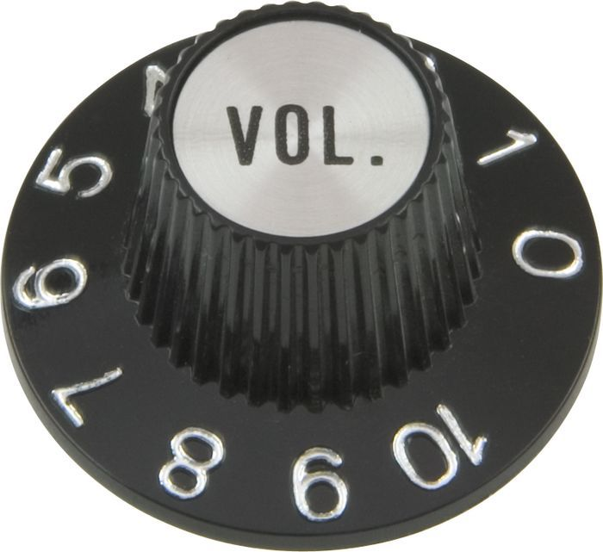
Types are optional!
Notes:
TODO: picture with volume dial

Slide 15
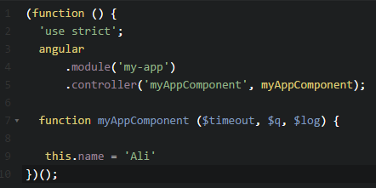
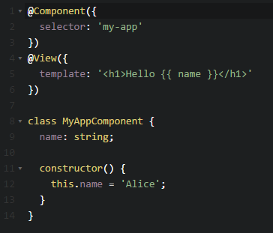
Angular 1.x vs Angular 2.0

Slide 16
At SSW we recommend TypeScript
Static types for compile time checking
Tooling – Rename, intellisense, got to definition etc
ES6
Interfaces and non ES6 features
Angular 2.0 ready

Slide 17

Benefiting from TypeScript
How strictly you will type things
How to use integrate with 3rd party tools
Steep learning curve
Another package manager

Slide 18
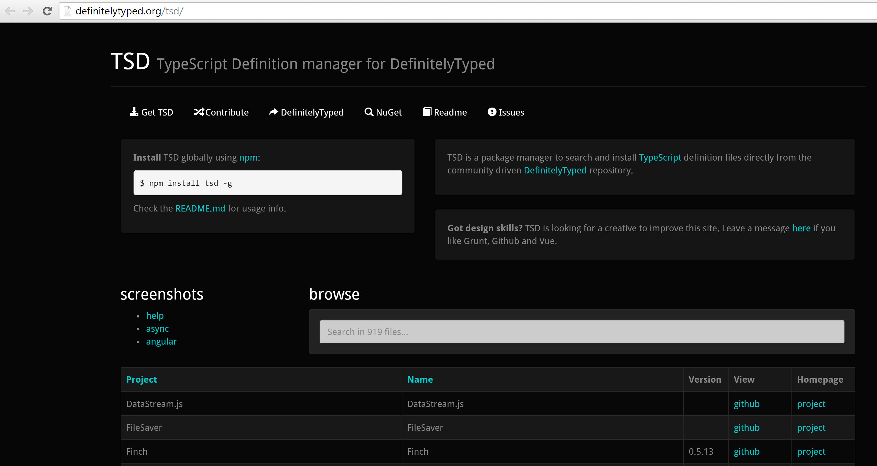

Slide 19
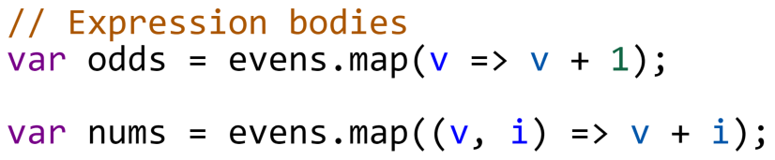
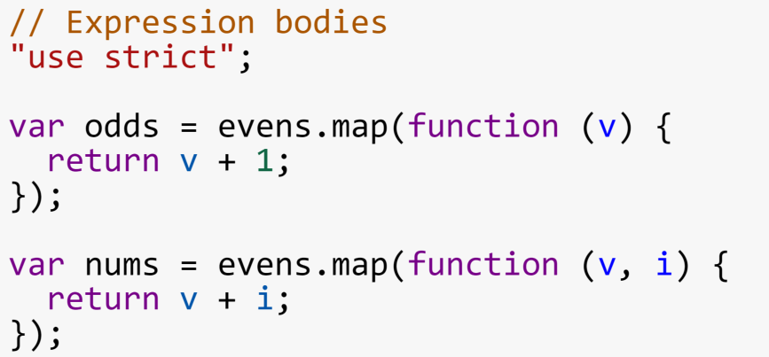
Arrows and Expression Bodies
ES6
ES5

Slide 20
Arrows – Statement Bodies
ES6
ES5

Slide 21
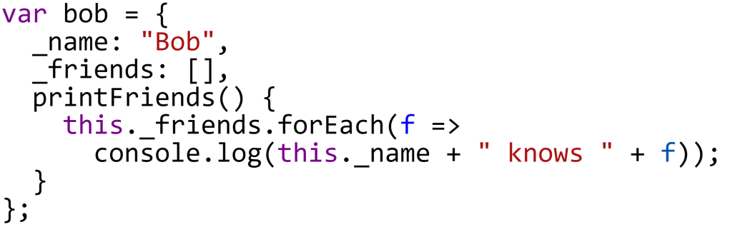
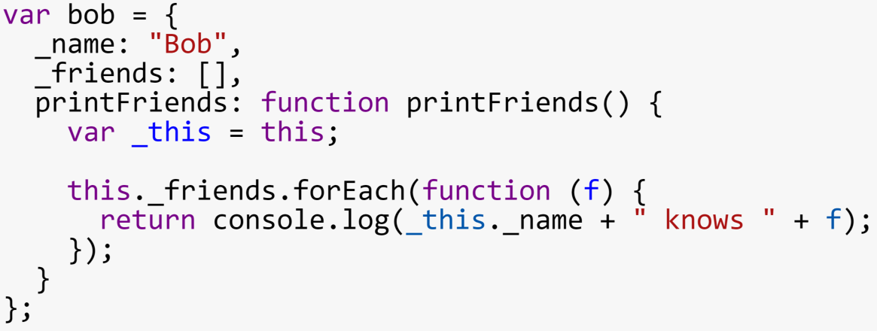
Arrows and Lexical This
ES6
ES5

Slide 22
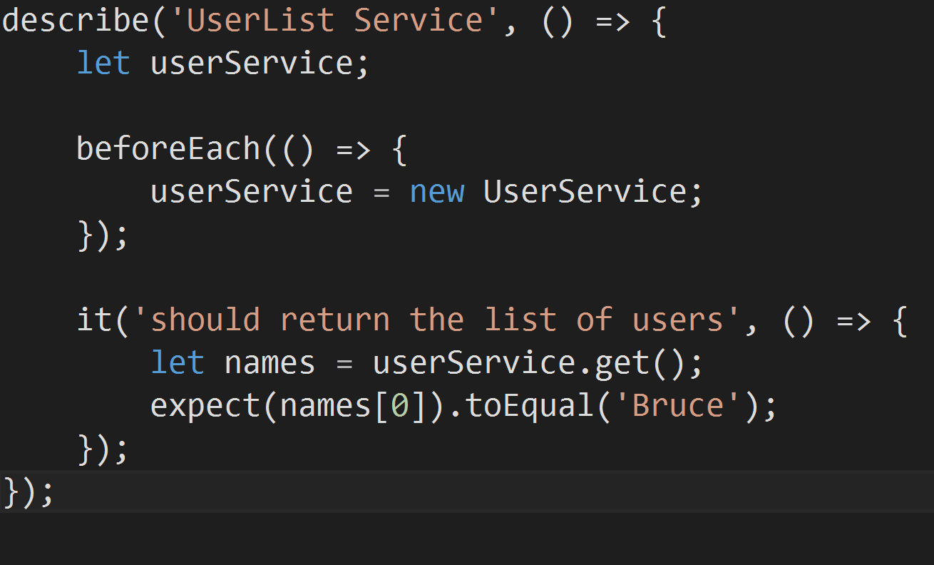
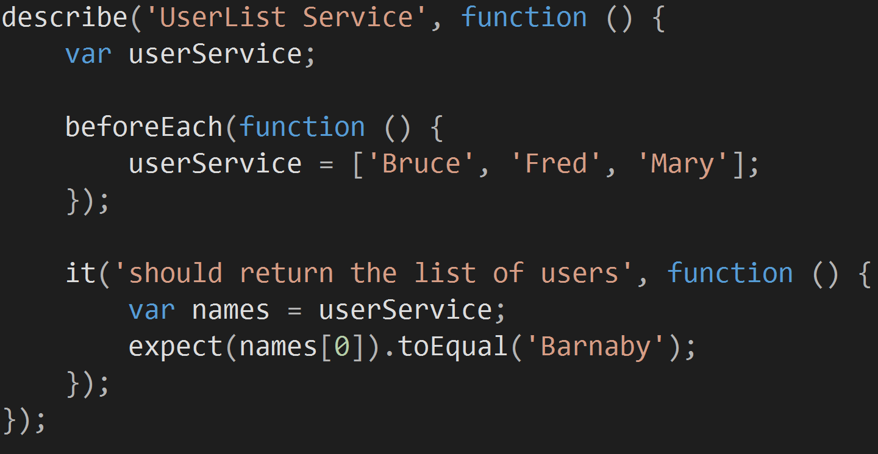
ES6
ES5

Slide 23
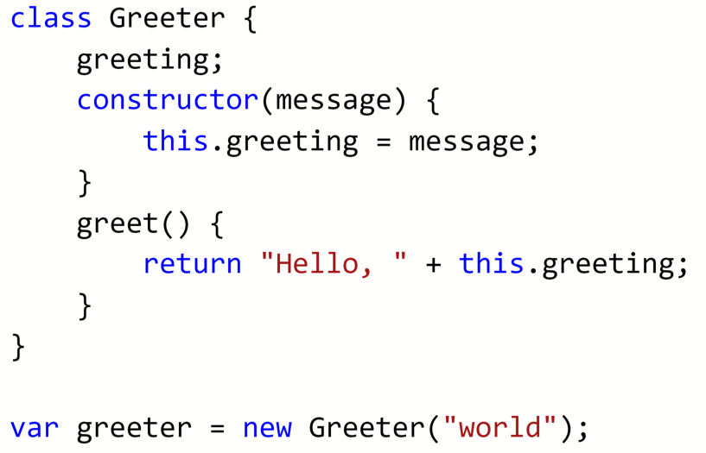
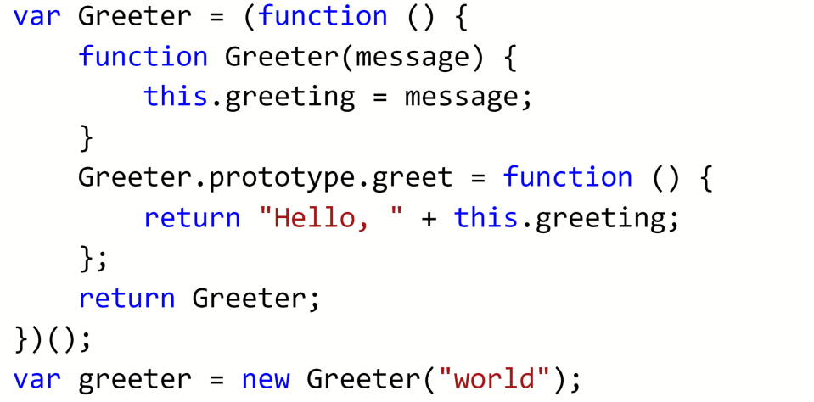
Classes
ES6
ES5

Slide 24
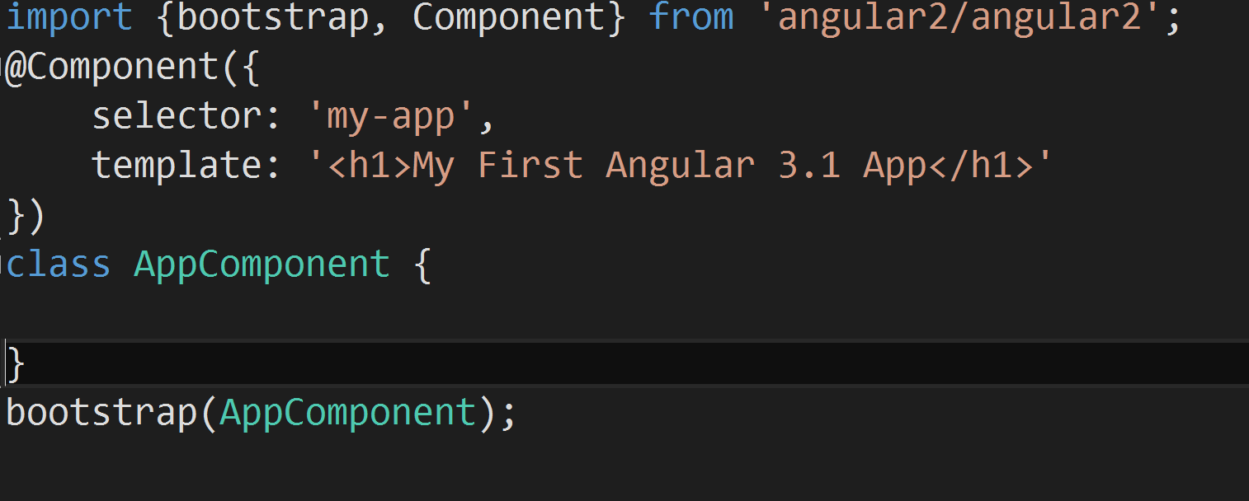
Classes in Angular2

Slide 25
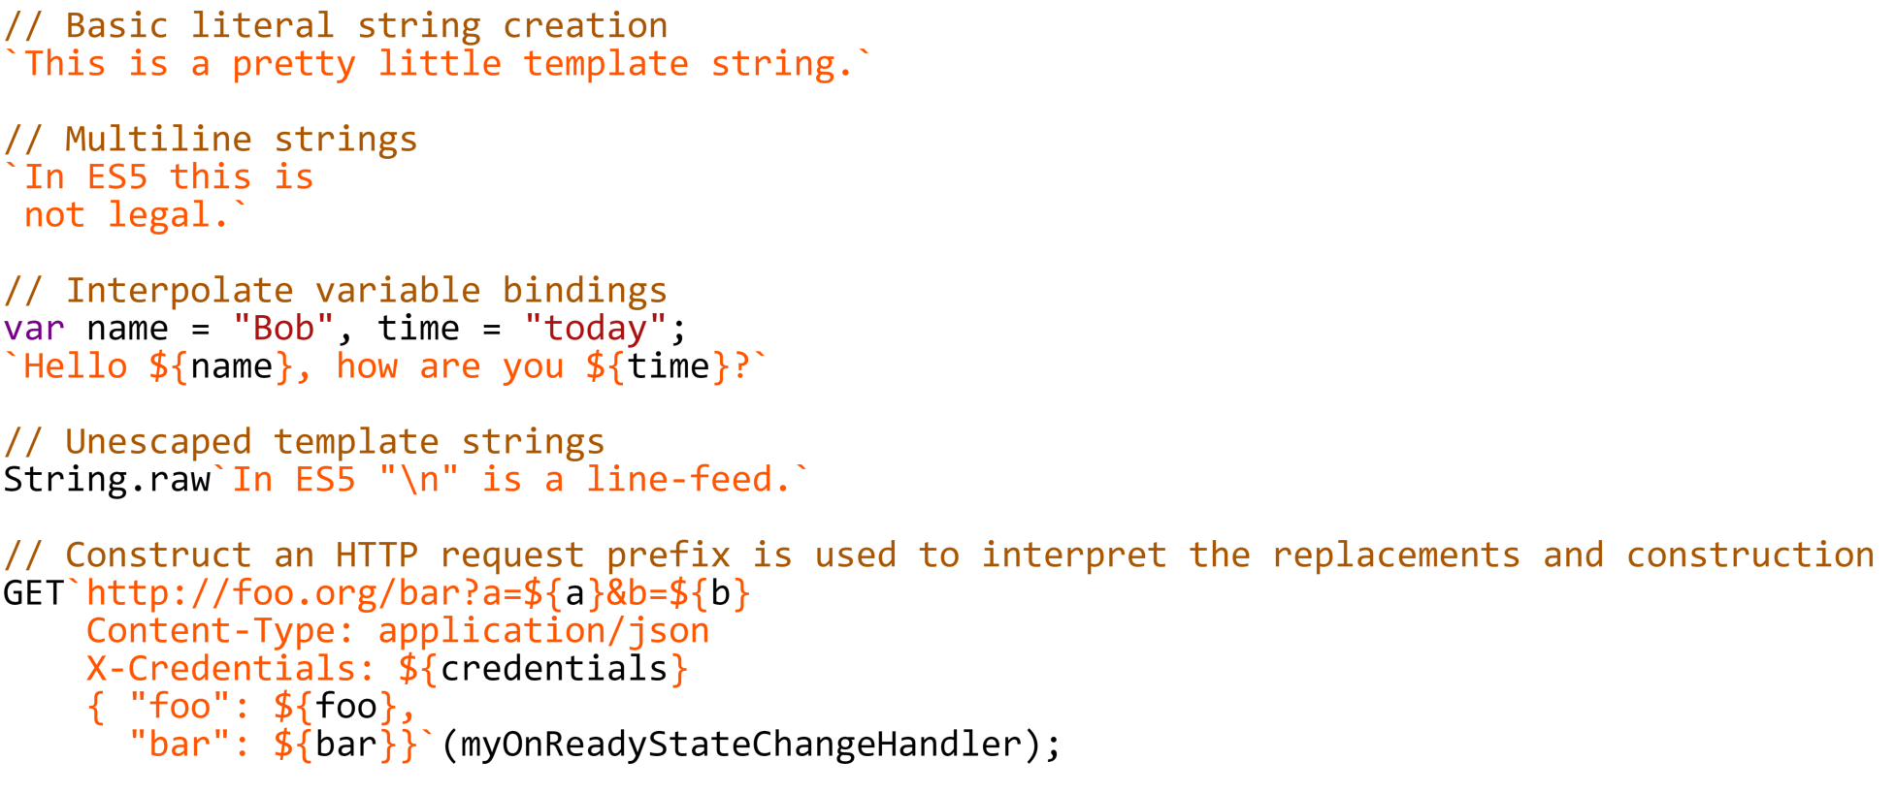
String literals
ES6

Slide 26
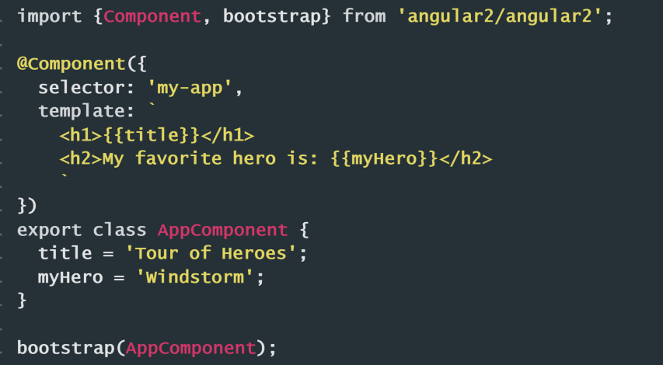
String literals
ES6

Slide 27
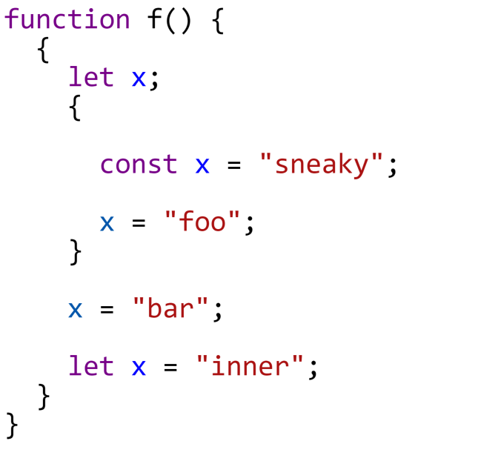
Let and const
ES6

Slide 28
Let and const
ES6

Slide 29
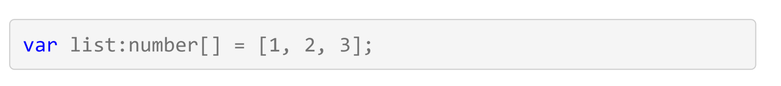
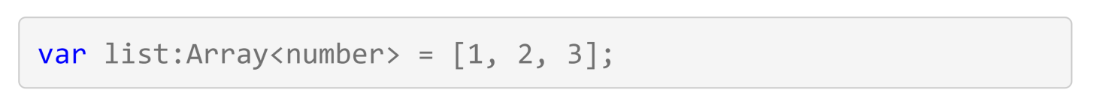
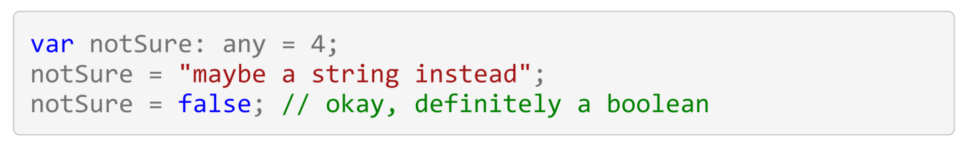
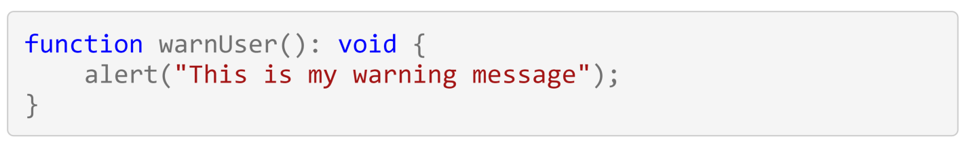
TypeScript Types
TS

Slide 30
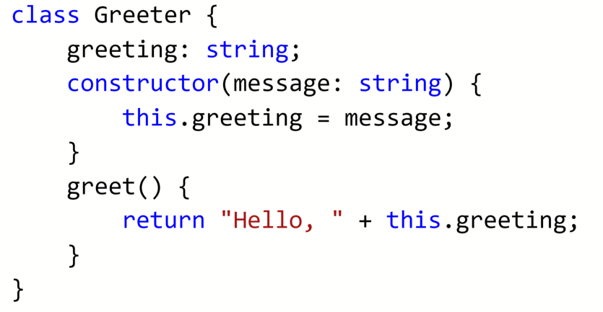

TypeScript Classes
TS

Slide 31
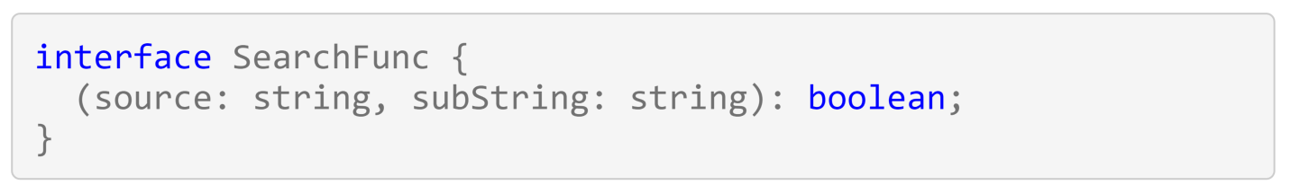
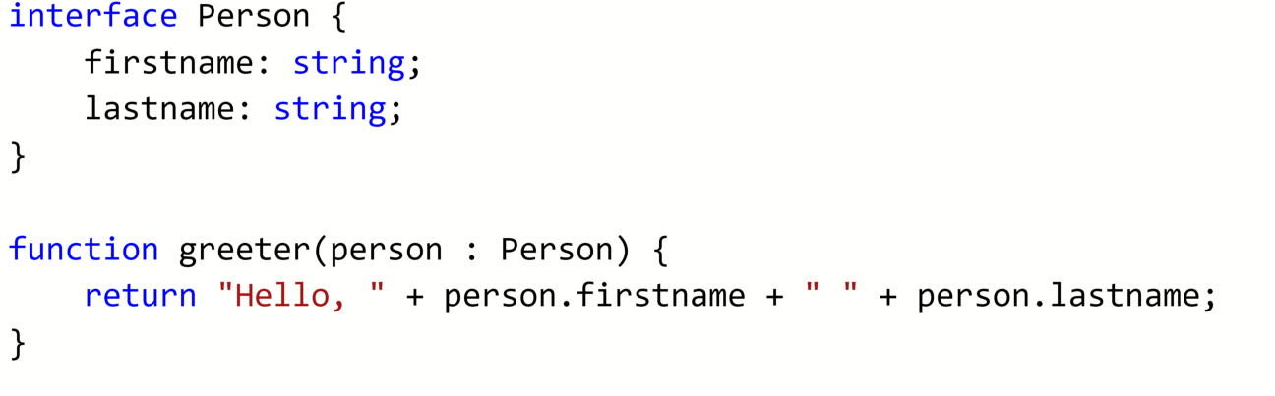
TypeScript Interfaces
TS

Slide 32
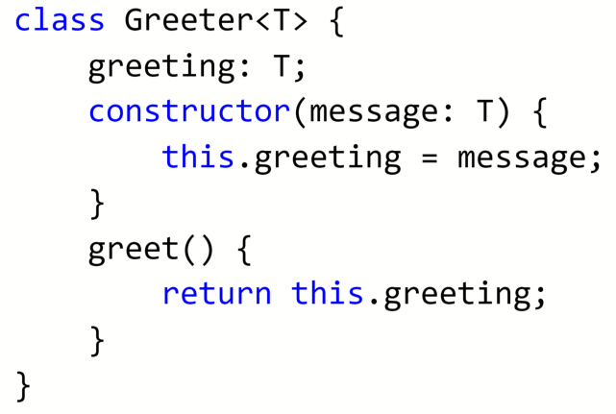
TypeScript Generics
TS

Slide 33
TypeScript Decorators
TS
@Component({
selector: 'cart',
templateUrl: './components/cart/cart.html',
styleUrls: ['./components/cart/cart.css'],
directives: []
})

Slide 34
TypeScript Code Demo - Tooling
Auto completion
Rename
Go to definition
Type Checking

Slide 35
We will all need to make this decision?

Slide 36
Summary
1. ES6 is awesome and needs to be transpiled
2. ES6 versus TypeScript
3. New ES6 features
4. Typescript 101
Notes:
Approx. 45min for the 10 qu and the Q&A

Slide 37
Thanks
@DuncHunter
Join the Conversation #AngularSuperPowersTour @DuncHunter @AdamStephesen
Notes:
The dependency injection mechanism will be used with the decorators syntax provided by TypeScript
No more strange minification safe $inject or automated tasks with ng-annotate.

